Slide 1
Ophthalmology History taking
Abrar saraireh

Slide 2
Importance of good history
Focuses your attention to the patients problem
Narrows down your deferential diagnosis
Screen the patient for other disease, the patient might not be aware of.
Protect other people from harmful events inflected on others, because of the patients problem.

Slide 3
history Components
patient Profile
Chief complaint
History of present illness
Past ophthalmic history
Past medical history
Drug history
Family history
Social history
Allergies

Slide 4
Patient profile
Name of the patient
Age
Sex
Residence
Work

Slide 5
Chief complaint
Main symptoms
1- blurred of vision
2- red eye
3- eye pain
4- itching
5- lacrimation .

Slide 6
Blurred of vision
When the patient present with a change in vision ask about :
- Did the change in vision start suddenly or gradually?
-How is the vision affected exactly? ( is it loss of vision? Cloudy vision? Floaters? )
-Unilateral or bilateral?
-Whole or part of the visual field affected?
-If partial, which part of the visual field affected

Slide 7
Blurring of vision
Causes :
1- refractory error
2- Organic problem in the eye (cornea, lens, retina, vitreous, optic nerve disease)

Slide 8
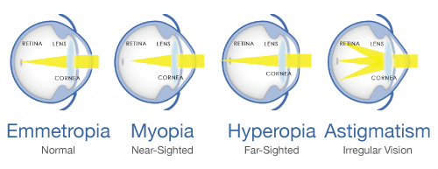

Slide 9
Blurred vision
Closed angle glaucoma
endophthalmitis
Keratitis
Uveitis
Optic neuritis!!
With pain

Slide 10
Blurred vision
Macular edema
Retinal detachment
Retinal hemorrhage
Retinal artery occlusion
Retinal vein occlusion
Without pain

Slide 11
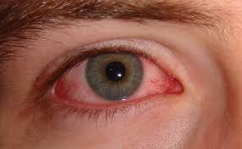
RED EYE
ASK :
If the eye is painful or photophobia ?
If vision is affected ?
Any recent trauma ?
Eye is itchy ?
Whether there is any discharge ?
Recent contact lens wear or foreign body exposure ?

Slide 12
Ocular pain
Site of pain
Severity
Aggravating factors
Relieving factors
Radiation
Associated symptoms, Nausea, vomiting, fever, weakness, headache.
History of associated trauma

Slide 13
Eye itching
Dryness
Eye allergy
Contact dermatitis
Eyelid mass (sclerosing basal cell carcinoma)
Blepharitis

Slide 14
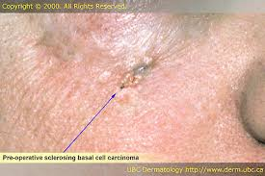

Slide 15
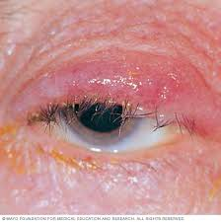

Slide 16
photophobia
Corneal symptoms : corneal abrasion , corneal ulcer
Uveitis with or without high intra-ocular pressure
Herpetic uveitis , Toxoplasmosis
HLA-B27 uveitis: ankylosing spondylitis, inflammatory bowel disease, psoriasis and Reiter's syndrome
Headache , Migraine (classical and common)

Slide 17
Floaters
The sense of swimming flies or amorphous organism in space that are no sticking to one side of visual field, typically floaters change position with eye movement
Uveitis
Vitreous detachment

Slide 19
Lacrimation and discharge
- Is the discharge clear or opaque?
- Associated pain? Foreign body sensation? Itchiness?
- Other symptoms (red eye)?

Slide 20
Past medical history
History of D.M , Dyslipidemia , HT: ask about duration, control, complication, medications ( type and compliance)
Congenital diseases ( bleeding disorders)
Drug allergies
History of uveitis or any medical eye problems.

Slide 21
Drug history
- Insulin
- HTN treatment
- Chloroquine > Retinal toxicity
- Isoniazid
- Steroids > ( Acute : Glaucoma , Chronic Use : cataract )

Slide 22
Social history
Smoking and alcohol use: this may affect vascular and optic nerve function within the eye.
Occupation:
certain occupations are more likely to get injured in the eye more than others.
certain professions, including drivers of heavy goods and pilots, require specific visual acuity criteria.
Visual impairment has a wide range of effects on daily life. Ask about:
Daily activities requiring good vision: reading, television, sport, hobbies and so on.
Driving.

Slide 23
Past surgical history
Previous surgeries
Previous use of eye glasses
Previous eye injections .
Previous laser to the eye.

